Slide 1

Website Application Software
Created using
Html
Css
Php
MySql
Xampp Server
PhpMyAdmin

Slide 2
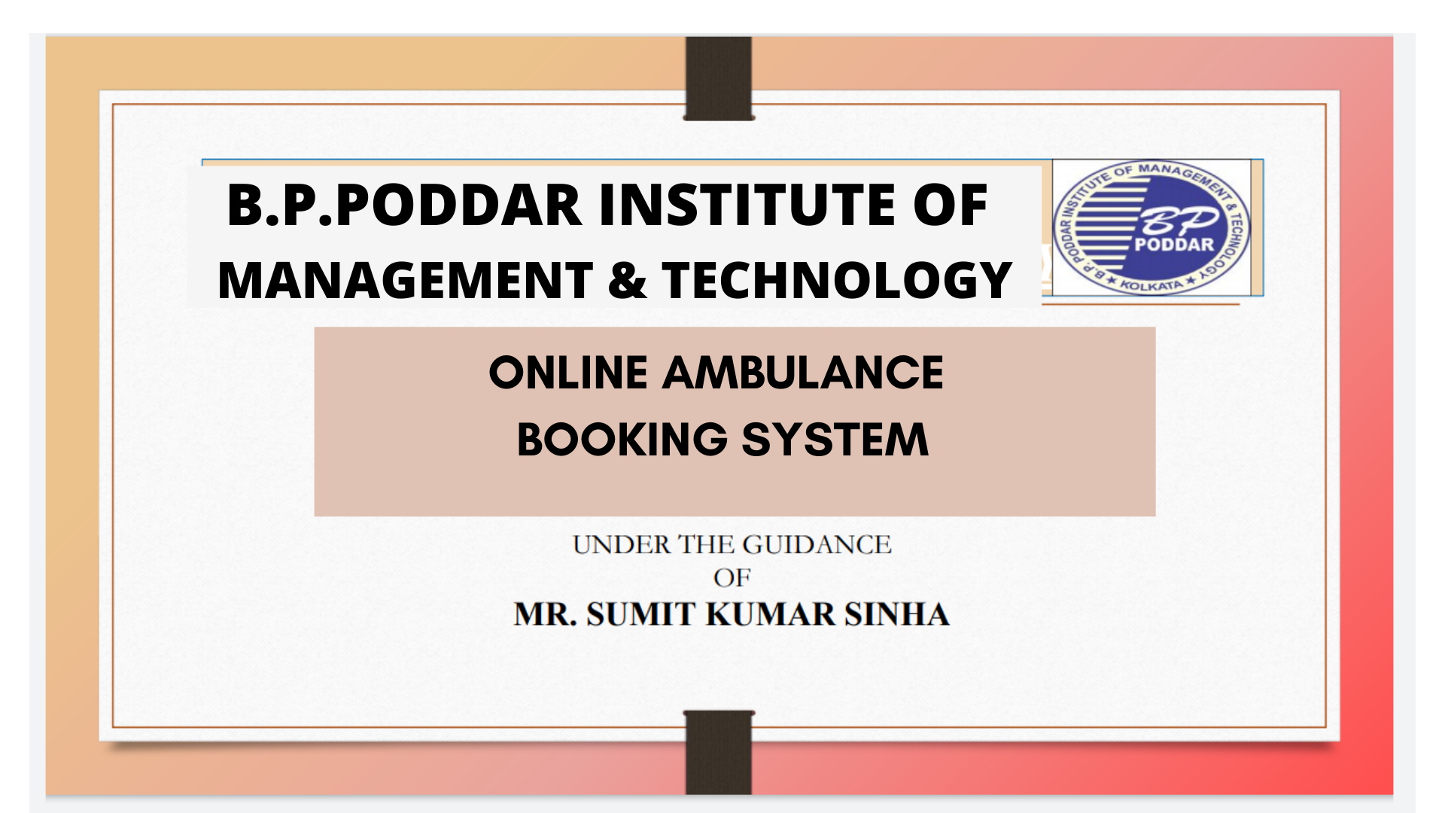

Slide 3
GROUP MEMBERS
Subhajit Dey - 30101217005
Subhajit Basu - 30101217006
Saheli Basu - 30101217019
Indranil Chowdhury - 30101217055
Ankita Mukherjee - 30101217074

Slide 4
FEASIBILITY STUDY
Legal Feasibility
Technical Feasibility
Economic Feasibility
Feasibility Study
Operational Feasibility
Schedule Feasibility
Behavioural Feasibility

Slide 5



SCOPE OF THE PROJECT
INFORMATION MANAGEMENT
The information of all user were stored in individual ambulance account.
RANGE OF CHOICES
‘AROGYA’ a web based application that provides to view and select the bookings of ambulance into different locations.
PRICE COMPARISON
The system will allow us to compare prices of booking from different locations.

Slide 6

TYPES OF USER
ADMIN
CUSTOMER
HOSPITAL
AMBULANCE

Slide 7
COST ANALYSIS
‘AROGYA’ is an web application which acts as a communication interface between patients ,ambulance and hospitals . The development team comprises of five team members , which is reasonably small, and the team members are experienced in developing the system. Therefore , this project can be considered as of organic type. Thus, for calculating development time we choose intermediate COCOMO estimation model for organic type
Effort = a1 * (KLOC) a2 *(EAF) PM
Development time= b1 *(Effort) b2 months
KLOC is the estimated size of the software product indicate in Kilo Lines of Code
SOFTWARE PROJECTS | A | B | C | D
Organic | 2.4 | 1.05 | 2.5 | 0.38

Slide 8
FACTORS | HIGH
Software reliability(f1) | 1.15
Product complexity(f2) | 1.15
Turnaround time(f3) | 1.07
Analyst Capability(f4) | 0.86
Application experience(f5) | 0.91
Programming Language Experience(f6) | 0.95
Use of software tools(f7) | 0.91
EAF =f1*f2*f3*f4*f5*f6*f7
=1.15*1.15*1.07*0.86*0.91*0.95*0.91
=0.9574
The lines of code are estimated to be 2500
Therefore,
KLOC=2.5 Therefore,
Effort=2.4(2.5) 1.05*0.9574 PM
=6.03162
Tdev=2.5*(6.03162)0.38 months
=5.730039 months
=153 days

Slide 9
DATA FLOW DIAGRAM
0 level diagram
ONLINE AMBULANCE BOOKING SYSTEM
USER
ADMIN
Request service
Software setting
Given Response
reports
Given Response
Check the Availability
AMBULANCE

Slide 10
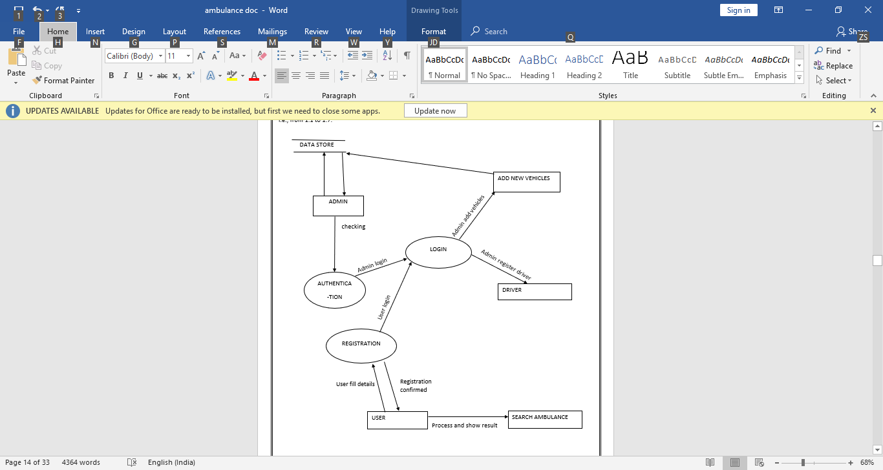
Level 1 DFD:

Slide 11
ENTITY RELATIONSHIP DIAGRAM
client_id
N
Messages
1
Client
ADMIN
N
status
password
N
1
H_NAME
Admin_id
Hiered by
location
Id_no
Done by
Sent by
Car_id
Car_name
N
Car_id
Hire_id
status
status
Car
1
N
time
message
Car_type
Hire
hirecost
Client_id
Message
image
status
Client_id
capacity
Message_id

Slide 12
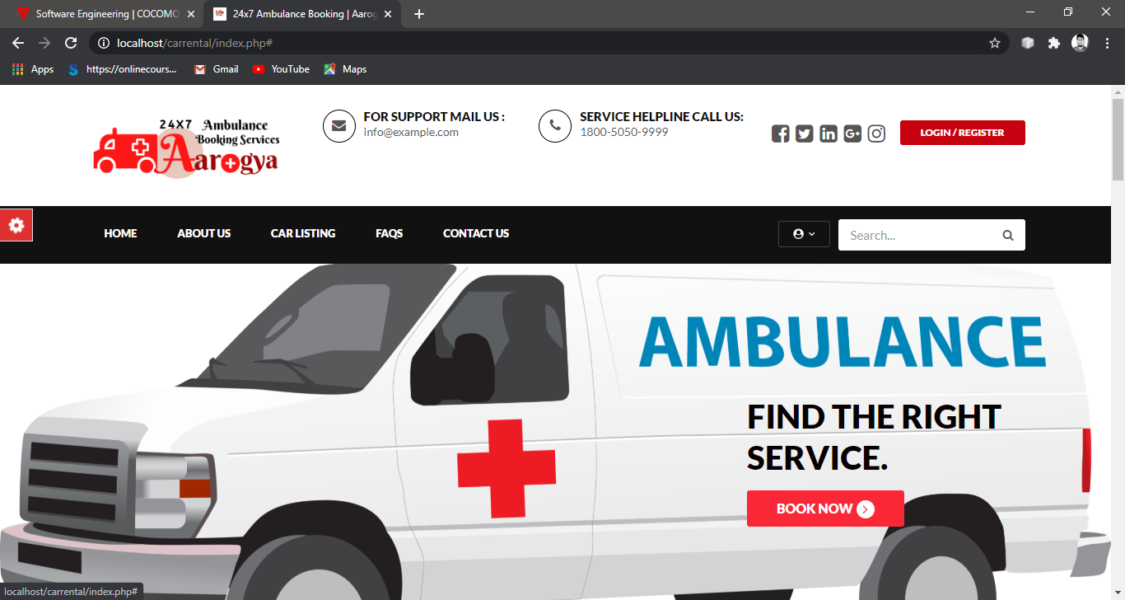
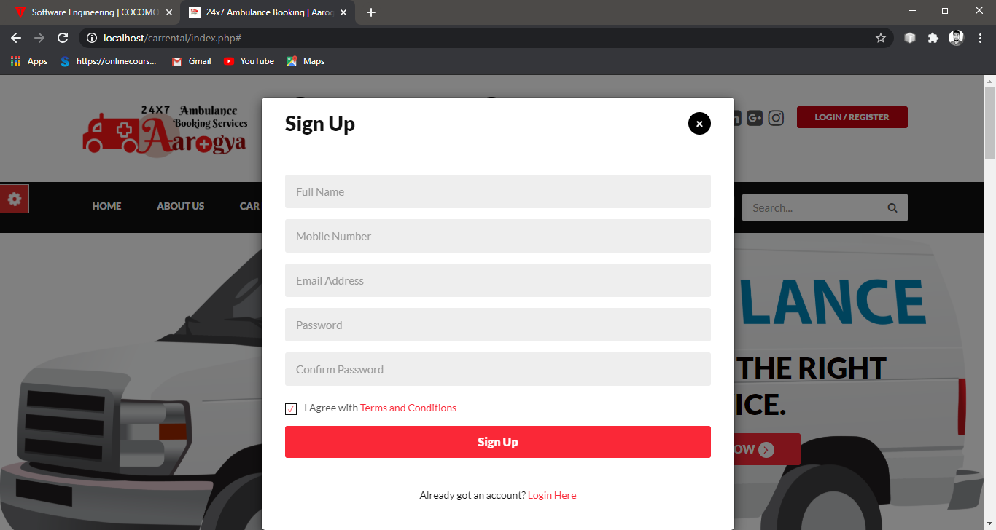
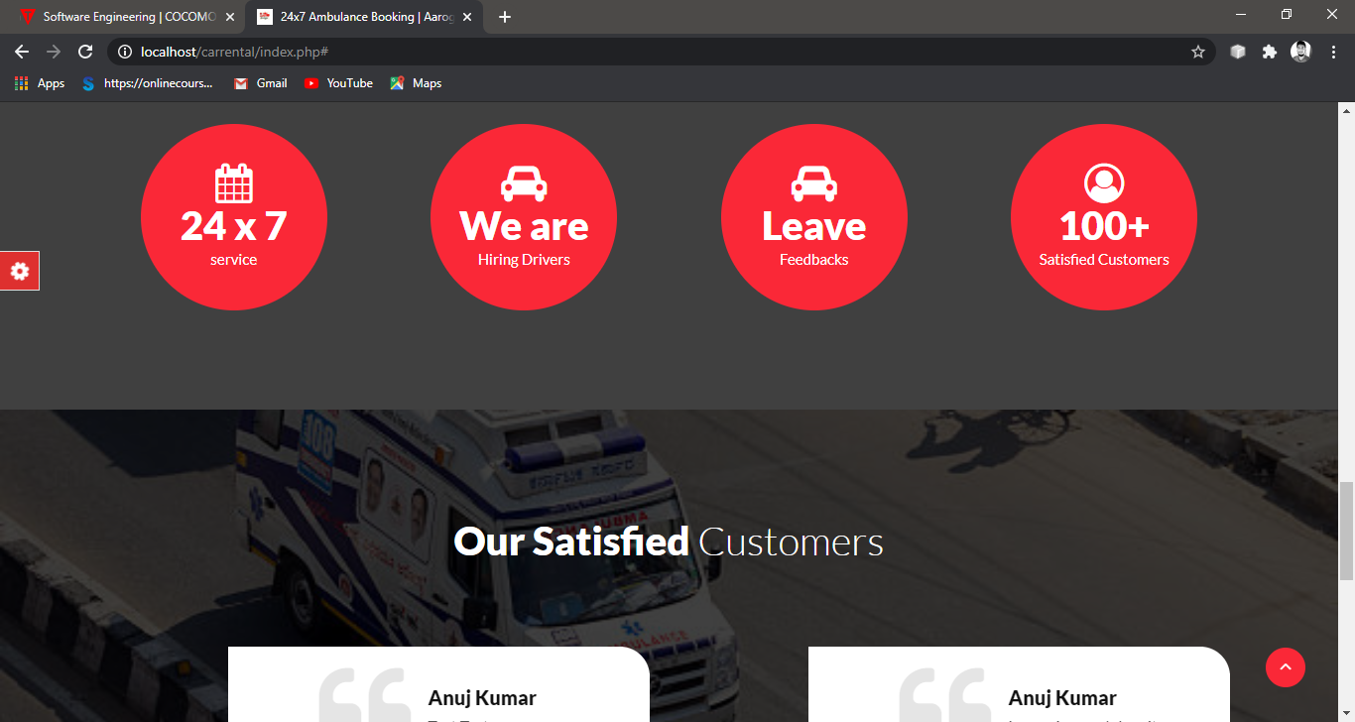
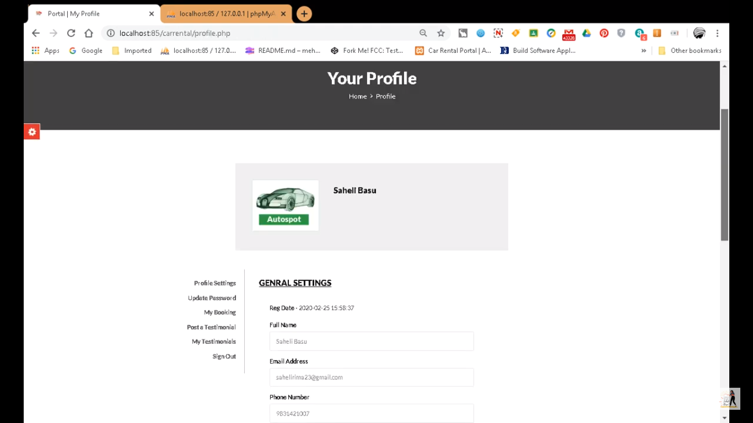

Slide 13
CONCLUSION:
The prototype we envisioned during the initial phase of the project has been successfully implemented and is up and running as a software application.
This software application has been designed to meet the features mentioned earlier. The page designing has been done using HTML, CSS and PHP. The document has been fully approved by our mentor which we have documented here .

Slide 14
FUTURE SCOPE:
Features like geo-location tracking and the range of service availability has the scope to be improved eventually and with respect to the provisions granted or requested from the original creators of the first ever 24x7 Online Ambulance Booking Facility.
Apart from that it’s an ambulance service that aims to reach out as a ray of hope for the masses.

Slide 15
BIBLIOGRAPHY:
i. Software Engineering Book by K.K. Agarwal
ii. Software Designing & Engineering Book by Rajib Mall
iii.www.phphub.com
iv. www.w3schools.com
v. www.geeksforgeeks.com

Slide 16
THANK YOU

